Slide 1
Machine Learning Model for Student Loan Investment Analysis
Capstone Project Presentation
BY: Isfund Ali Akram

Slide 2
Project Goal
To create a machine learning model to predict repayment risk and employment outcomes

Slide 3
Datasets
01
02
Loan Debt
Credit Score
03
04
Payment Status
Career Salaries
Datasets

Slide 4
Flowchart
Train Model
Model Predicts Risk Levels
Investment Risks Due To Loan Repayment Uncertainty

Slide 5
Machine Learning Process
ANALYZE
Analyze employment outcomes based on degrees and universities
Machine Learning Objective
PREDICT
Predict loan repayment capability
CATEGORIZE
High-Risk
Medium Risk
Low-Risk

Slide 6
Input-Output
IN
OUT
Repayment Risk Level
Loan Amount | Payment Deliqnuency | Degree | Default Rate | Delinquincy

Slide 7
Machine learning Models
Random Forest Classifier
Linear Regression
Predicted salaries with Mean Squared Error of 12%
85% Accuracy for loan risk categorization

Slide 8
PROCESS
01
02
03
04
DATA PROCESSING
Feature engineering
MODEL TRAINING
PREDICTIONS

Slide 9
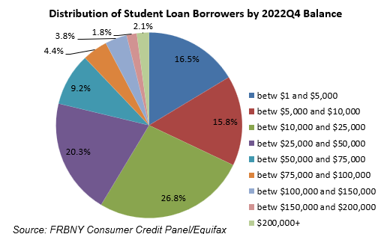
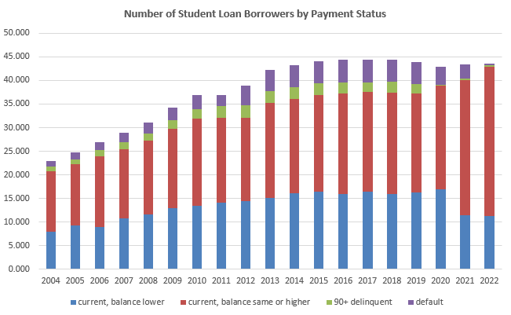
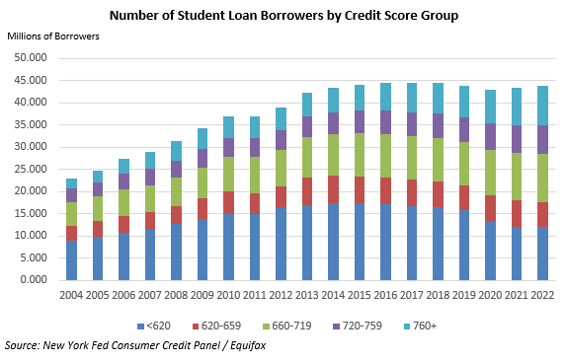
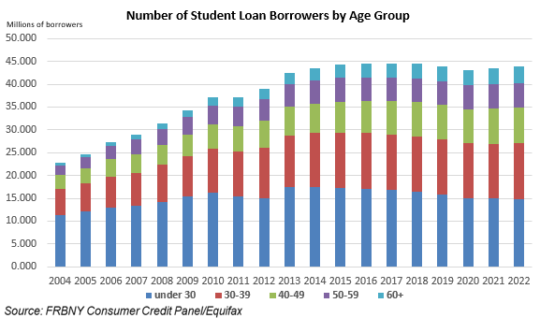
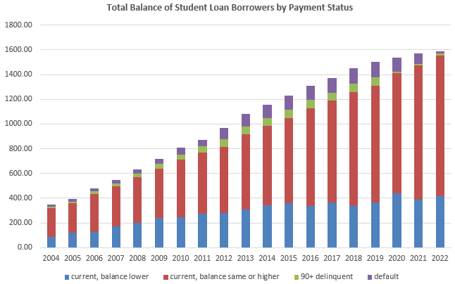
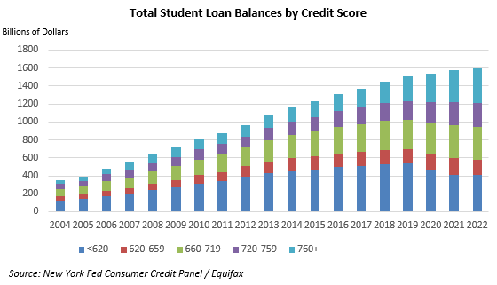
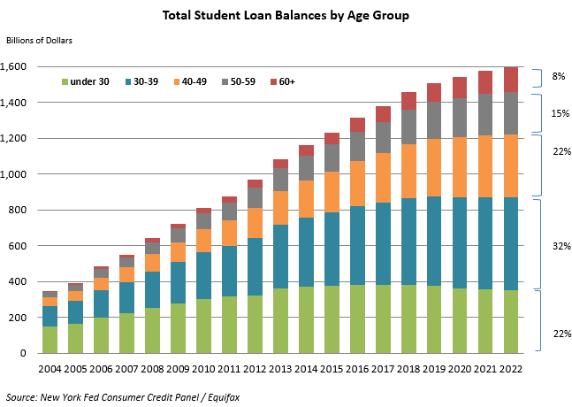
Data Visualization

Slide 10
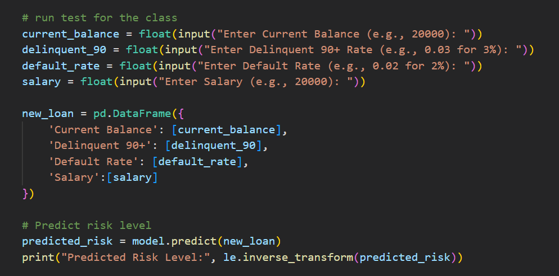
Python Live Example
The result will output – High-Risk, Medium-Risk, or Low-Risk respectively

Slide 11
Thank You!
QUESTIONS!

Slide 12
REFERENCES
https://research.com/degrees/highest-paying-bachelors-degrees
https://educationdata.org/student-loan-debt-by-major
https://www.newyorkfed.org/microeconomics/topics/student-debt

